Slide 1
Overview Office of substance abuse prevention (OSAP)
grants and Team

Slide 2
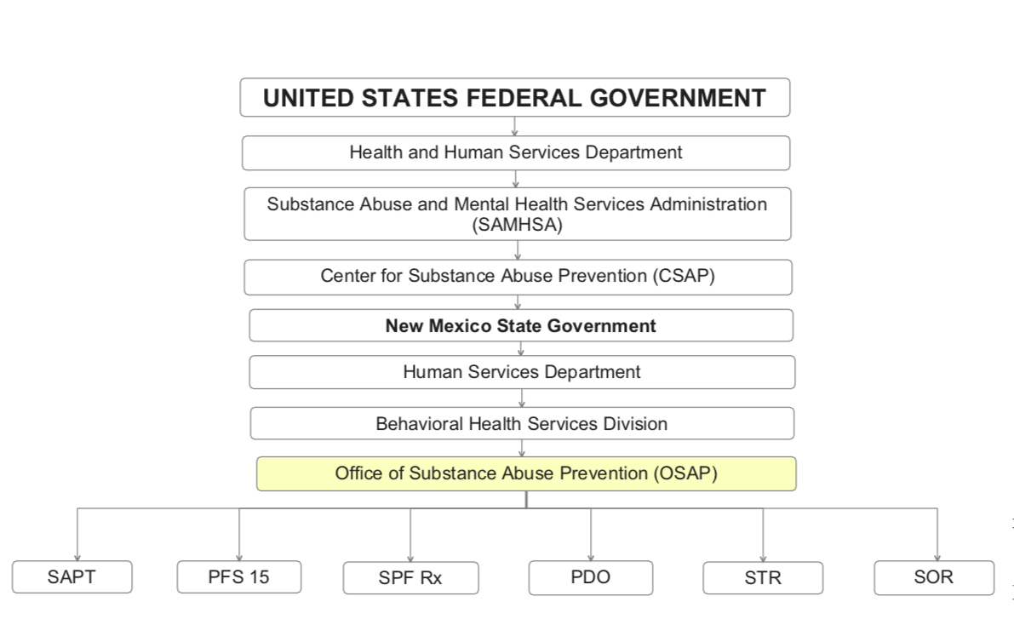
OSAP FUNDING STRUCTURE
Diagram courtesy of Paula Feathers, Principal, Kamama Consulting, New Mexico ATODA Prevention Workforce

Slide 3
Team OSAP
Karen Cheman, OSAP Director
Antonette Silva-Jose, Staff Manager
Heather Burnham, Program Manager
Vacant Program Manager
Rebecca Leppala, SOR Program Manager
Vacant PDO Program Manager
Jay Quintana, Synar Coordinator

Slide 4
Current grants and their Acronyms
SAPT - Substance Abuse Prevention Treatment Block Grant
PFS 15 – Partnerships for Success 2015
SPF Rx – Strategic Prevention Framework for Prescription Drugs
PDO – Prevent Prescription Drug/Opioid Overdose-Related Deaths
STR Extension – State Targeted Response to the Opioid Crisis Extension
SOR – State Opioid Response Grant

Slide 5
SAPT - Substance Abuse Prevention & Treatment Block Grant
Reduces underage drinking
Reduces adult binge drinking
Reduces adult DWI
Reduces prescription opioid and illicit opioid misuse among youth and adults
Synar – youth tobacco use prevention
OSAP Contacts
Karen Cheman
Antonette (Tone) Silva-Jose
Heather Burnham
Jay Quintana

Slide 6
PFS 15 – Partnerships for Success 2015
Addresses underage drinking among persons aged 12 to 20
Addresses prescription drug misuse and abuse among persons aged 12 to 25
OSAP Contact
Karen Cheman
Heather Burnham

Slide 7
SPF Rx – Strategic Prevention Framework for Prescription Drugs
Raises awareness about the dangers of sharing medications
Works with pharmaceutical and medical communities on the risks of overprescribing to young adults
Uses the Prescription Drug Monitoring Program (PDMP) data
OSAP Contact
Karen Cheman
Antonette (Tone) Silva-Jose

Slide 8
PDO – Prevent Prescription Drug/Opioid Overdose-Related Deaths
Reduces the number of prescription drug/opioid overdose-related deaths for individuals 18 years of age and older
Overdose recognition and response trainings
Purchase and distribution of naloxone
OSAP Contact
Karen Cheman
Rebecca Leppala, Interim Program Manager

Slide 9
STR – State Targeted Response to the Opioid Crisis Extension
Reduces opioid overdose related deaths through the provision of prevention and harm reduction activities
Tribal opioid outreach
OSAP Contact
Karen Cheman
Rebecca Leppala
Jay Quintana

Slide 10
Sor
OSAP Contacts
Karen Cheman
Rebecca Leppala
Antonette (Tone) Silva-Jose
Jay Quintana
PAX Good Behavior Game (PAX GBG)
Indigenous PAX
Overdose Prevention Education and Harm Reduction
A Dose of Rxeality Campaign (ADOR)

Slide 11
SOR – State Opioid Response Grant
Reduces opioid overdose related deaths through the provision of prevention, harm reduction, overdose survivor follow-up activities
Tribal LEAD Program is pre-arrest diversion for substance use disorders

Slide 12
Tribal Nations
OSAP works with Tribal Nations across New Mexico on primary prevention to reduce alcohol misuse and prescription opioid misuse and overdose death prevention
OSAP Contact
Karen Cheman
Antonette (Tone) Silva-Jose
Jay Quintana

Slide 13
Thank you!
For more information about OSAP or OSAP Programs, please contact
OSAP Director Karen Cheman at Karen.Cheman@state.nm.us

